Slide 1
RESEARCH AND PLANNING AT THE HRDA
FORECASTS OF LABOUR DEMAND AND SUPPLY IN THE CYPRUS ECONOMY 2022 – 2032
Research and Planning Directorate
Yiannis Mourouzides
Senior Human Resource Officer

Slide 2
THE PRESENTATION
Aim of the study
Scope of the study
Methodology
Forecasts of labour demand
Forecasts of labour supply
Online tool for the forecasts of labour demand in occupations

Slide 3
1. AIM OF THE STUDY
The study aims to provide forecasts of both labour demand and supply in the Cyprus economy during the period 2022-2032.
This constitutes a necessary input for the proper and timely planning and implementation of education and training activities.
3

Slide 4
2. SCOPE OF THE STUDY (1)
Forecasts
2022-2032
Labour demand
forecasts
Labour supply
forecasts
4

Slide 5
2. SCOPE OF THE STUDY (2)
Labour demand forecasts
2022-2032
52 economic sectors
309 occupations
5

Slide 6
2. SCOPE OF THE STUDY (3)
Employment
Replacement demand
Labour demand forecasts
2022-2032
Expansion demand
Total employment
demand
6

Slide 7
2. SCOPE OF THE STUDY (4)
Labour supply forecasts
2022-2032
Total economy
Gender
Education level
7

Slide 8
3. METHODOLOGY
It was developed by the Research and Planning Directorate of the HRDA and was based on its long experience in providing employment forecasts in Cyprus as well as similar methodologies in European countries.
The strategic objectives of Cyprus were considered, as expressed in various national programming documents, and specific assumptions and working scenarios were adopted, which are presented in the study.
The annual percentage change in total employment was provided by the Ministry of Finance, which is calculated in relation to the rate of change of GDP and productivity.
8

Slide 9
4.1 TOTAL EMPLOYMENT FOR THE PERIOD 2014-2032
9

Slide 10
4.2 ANNUAL AVERAGE TOTAL EMPLOYMENT DEMAND FOR THE PERIOD 2016-2032
10

Slide 11
4.3 EMPLOYMENT FORECASTS IN BROAD ECONOMIC SECTORS FOR THE PERIOD 2022-2032
11

Slide 12
4.4 EMPLOYMENT SHARES IN BROAD ECONOMIC SECTORS FOR THE PERIOD 2017-2032
12

Slide 13
4.5 THE 10 ECONOMIC SECTORS WITH THE HIGHEST
TOTAL EMPLOYMENT DEMAND FOR THE PERIOD 2022-2032
Retail trade (1.175 persons or 2,5% per year)
Education (1.108 persons or 3,0% per year)
Health and social work activities (1.038 persons or 4,0% per year)
Construction (854 persons or 2,1% per year)
Public administration and defence (782 persons or 1,9% per year)
Food and beverage service activities (710 persons or 3,8% per year)
Wholesale trade (565 persons or 2,4% per year)
Accommodation (466 persons or 3,6% per year)
Legal and accounting activities (456 persons or 2,2% per year)
Computer programming and information service activities (371 persons or 4,0% per year)
13

Slide 14
4.6 EMPLOYMENT FORECASTS IN BROAD OCCUPATIONAL CATEGORIES FOR THE PERIOD 2022-2032
14

Slide 15
4.7 EMPLOYMENT SHARES IN BROAD OCCUPATIONAL CATEGORIES FOR THE PERIOD 2017-2032
15

Slide 16
4.8 THE 10 OCCUPATIONAL GROUPS WITH THE HIGHEST
TOTAL EMPLOYMENT DEMAND FOR THE PERIOD 2022-2032
Sales workers (1.068 persons or 2,7% per year)
Cleaners and helpers (934 persons or 2,9% per year)
Personal service workers (868 persons or 3,1% per year)
Business and administration associate professionals (863 persons or 2,1% per year)
Teaching professionals (639 persons or 2,3% per year)
Building and related trades workers, excluding electricians (494 persons or 2,0% per year)
Health professionals (459 persons or 3,3% per year)
Drivers and mobile plant operators (419 persons or 2,5% per year)
Information and communications technology professionals (417 persons or 5,0% per year)
General and keyboard clerks (411 persons or 1,9% per year)
16

Slide 17
5.1 TOTAL ECONOMICALLY ACTIVE POPULATION AGED 15-64 FOR THE PERIOD 2014-2032
17

Slide 18
5.2 FORECASTS OF ECONOMICALLY ACTIVE POPULATION AGED 15-64 BY GENDER FOR THE PERIOD 2022-2032
18

Slide 19
5.3 FORECASTS OF ECONOMICALLY ACTIVE POPULATION AGED 15+ BY EDUCATION LEVEL FOR THE PERIOD 2022-2032
19

Slide 20
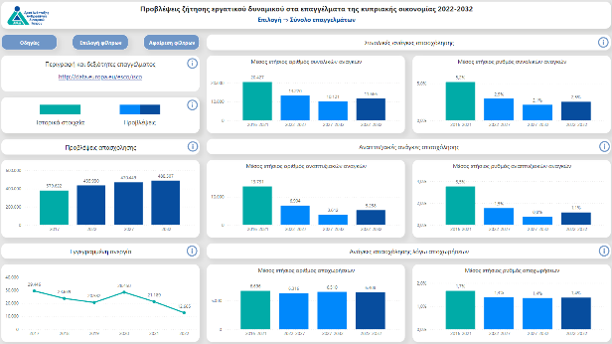
6. ONLINE TOOL FOR THE FORECASTS OF LABOUR DEMAND IN OCCUPATIONS (in Greek)
20

