Slide 1
Skills and employment trends in Europe
Jiri Branka

Slide 2
About Cedefop

Slide 3
Skills intelligence
Process of identifying, collecting, analysing, and presenting information on skills and labour market to:
Identify key trends and demands in the labour market;
Assess and forecast skill needs;
Address skill gaps and mismatches;
Adapt provision of education and training accordingly;
Provide support for educational and career guidance and counselling.

Slide 4
Cedefop’s Skills intelligence
Surveys
(ESJS, ECS)
Skills forecast
Online job advertisements
European skills index
Labour market indicators (LFS, SILC …)
Publications
Online tools
Data
Occupations
(blended) Skills intelligence
Sectors
Countries
Digitalisation
Green transition
Societal changes

Slide 5
Employment trends 2008-2022
Public services: 25% share on employment and rising
High tech sector rises the fastest
Primary and secondary sector losing significant amount of jobs
Covid-19 hardest hit sectors fully recovered

Slide 6
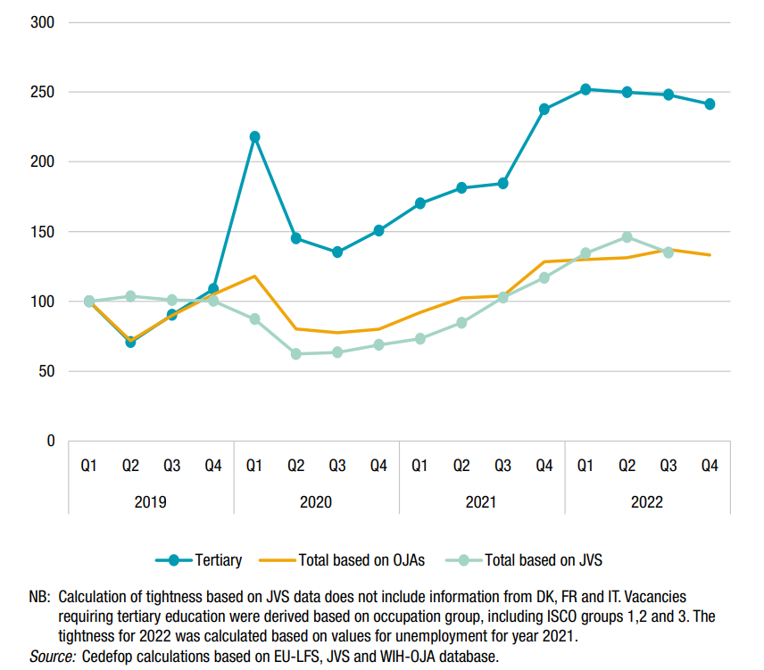
Labour market tightness
(Q1 2019 – 100)
The ratio of the number of vacancies offered by firms seeking to fill open positions relative to the number of would-be workers looking for jobs, proxied by the number of unemployed actively searching for work

Slide 7
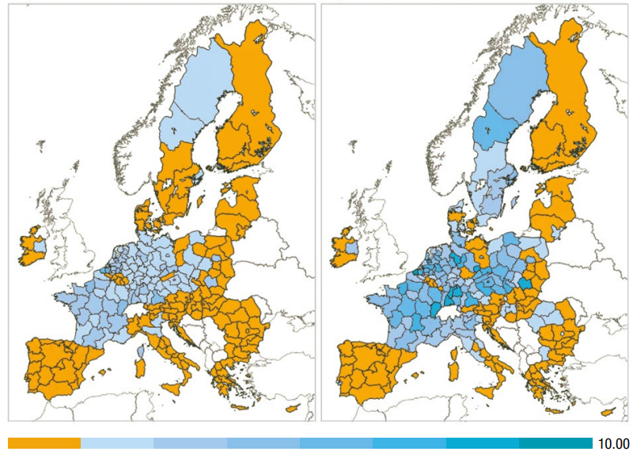
Labour market tightness across regions
Overall labour market tightness (left) and tightness for tertiary educated workers (right) in EU regions (Q4 2022)
The tightness for Q4 2022 was calculated based on the values of regional numbers of unemployed for 2021.
Scale from 0-10, with values below 1 marked in orange.

Slide 8
The labour market up to 2035
jobs are becoming more skills intensive
Millions
Jobs by skill level
Job openings in 2021-35
36%
46%
48%
43%
16%
11%
Millions
Source: Cedefop skills forecast 2021-35
8
Notes:
I’d like to present just one of the key findings of our latest skills forecast. And this is the fact that THE labour market megatrend is accelerating skills upgrading. So, up to 2035: the broad outlook is more jobs (employment) and more skills intensive jobs.
Forecasts are never a crystal ball, so we cannot put an exact date on it, but our analysis strongly suggests that shows it is very likely that already before 2035 there will be more high skilled jobs (requiring academic or High-level VET) than medium skilled jobs. ​
Skills upgrading is very visible in job openings: out of every 100 job openings up to 2035, 57 will be for people with a higher qualification; 41 for people with a medium level qualification only 2 for people with a lower qualification. ​
But - and this is very important, these forecasts are not an image of what happens by itself. We incorporate the EU policy framework and its targets (e.g. EGD). The trends the forecasts show will not materialise unless we invest in Europe’s people by giving them the skills they need, address skills shortages (already putting a brake on progress in some the IT, energy, and care sectors) and make our economies more green and digital.

Slide 9
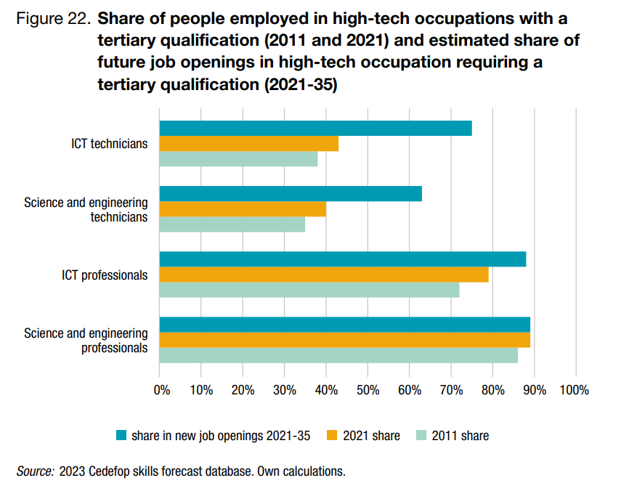
Rising qualification needs
Source: Cedefop skills forecast 2021-35

Slide 10
Future job demand
Source: Cedefop skills forecast 2021-35

Slide 11
Future job demand (2)
Social prestige?
Pay?
Working conditions?
Source: Cedefop skills forecast 2021-35

Slide 12
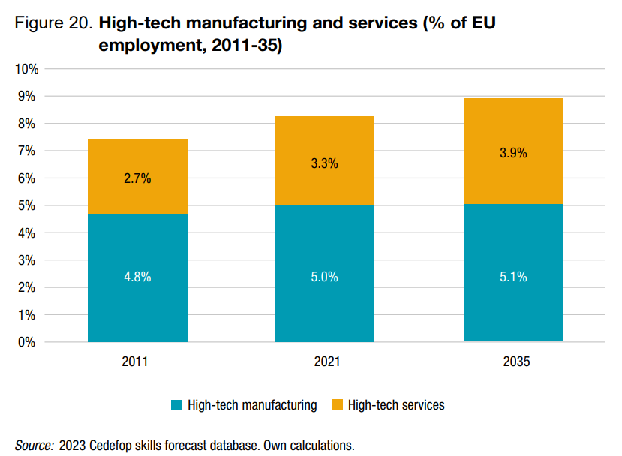
The digital transition
Source: Cedefop skills forecast 2021-35

Slide 13
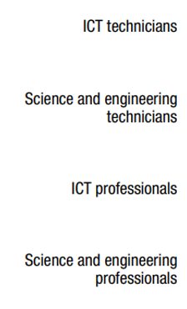
The digital transition (2)
Future growth 22-35
Past growth 09-22

Slide 14
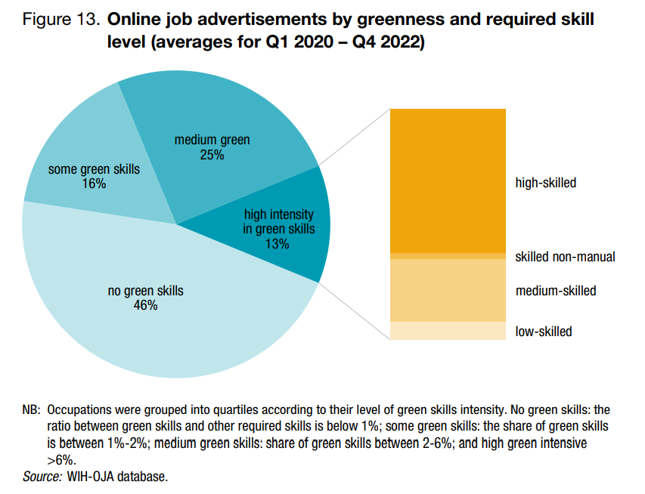
The green transition
Source: Cedefop skills forecast 2021-35

Slide 15
Green transition at company level
Four company case studies on green transition
Rising emphasis on HRM and reskilling, to absorb frictions caused by the transition
Important: collaboration with local learning ecosystems
Critical importance of jobs related to innovation and legislation, law and regulation
4 case studies to come in the following months

Slide 16
Recent skills intelligence publications
Skills in Transition: The way to 2035 | Handling change with care | The feasibility of using OJAs in analysing unmet demand | Going digital means skilling for digital
From linear thinking to green growth mindsets | Growing green | Too good to waste | Cities in transformation
Notes:
The Skills in Transition – the very recent flagship publication of the skills intelligence team, bringing together insights from employment, skills forecast and online job advertisement analysis

Slide 17
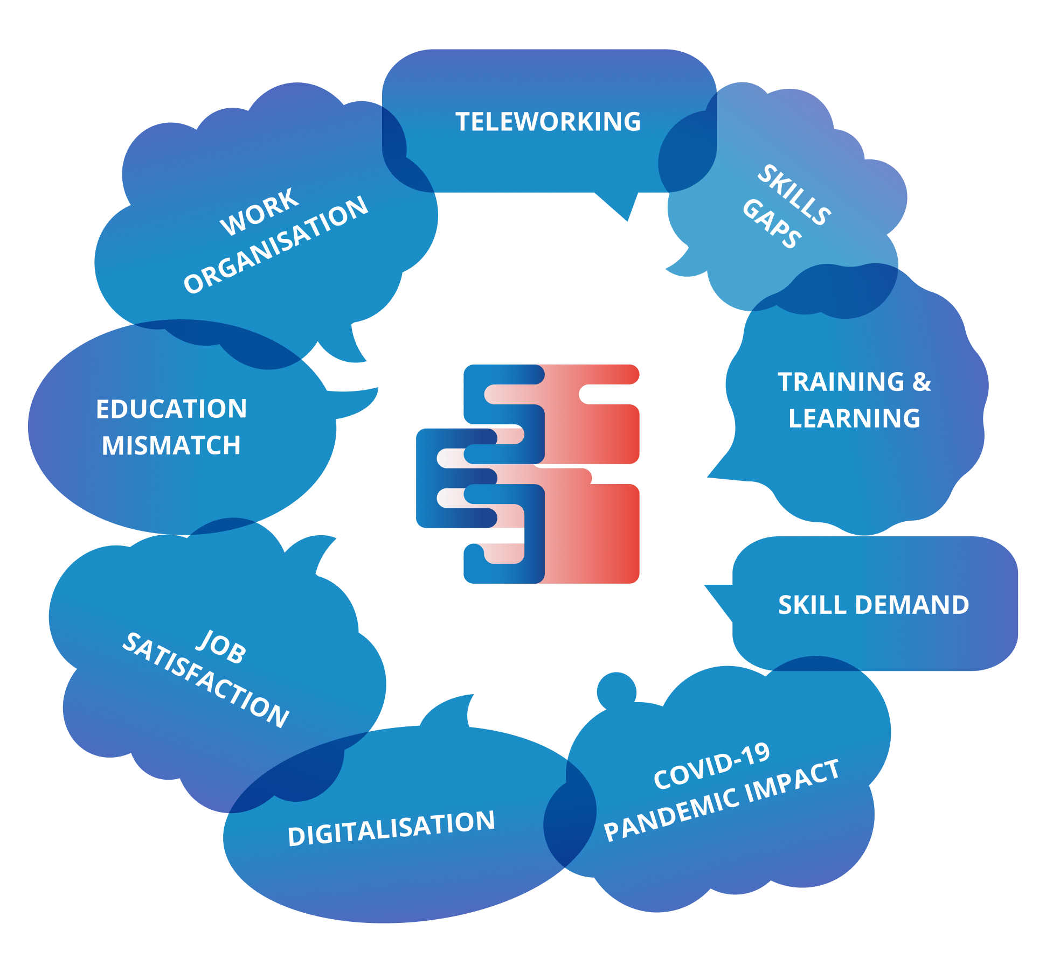
Check out our online tools
Skills forecast
Skills OVATE
European skills and jobs survey
Matching skills database
European skills index
Skills intelligence tool

Slide 18
Jiri Branka
jiri.branka@cedefop.europa.eu

