Slide 1

Final Report KA131 2021

Slide 2

Assessment criteria
Scoring of the final report of the project
The maximum score of the final report is 100 points.
If the final report scores below 60 points in total the NA may reduce the final grant amount for organisational support ( See Annex III of the beneficiary grant agreement)
For each assessment criterion, the maximum total points are indicated.
Deadline for Submission 30th December 2023.

Slide 3
Implementation performance (maximum 50 points) | Mobility activities The extent to which the planned mobility activities (as set out in the grant agreement) were achieved or exceeded and how the budget/grant was efficiently used, and relevance of the beneficiary’s explanations. Blended intensive programmes Question relating exclusively to projects with blended intensive programmes: The extent to which each blended intensive programme has reached its objectives, and the relevance of the beneficiary’s explanations.
Assessment criteria for KA131 projects

Slide 5
Assessment criteria for KA131 projects

Slide 6
1. Project summary
Please provide a summary of the information you have provided in the rest of the report
Please use full sentences and clear language
Do not use acronyms.
The summary you provide will be made public by the European Commission and the National Agencies.
Background and Objectives
What did you want to achieve by implementing the project?
Implementation
What activities did you implement (please also refer to the overview activities tables below)?
Results
What were the outcomes and impact of your project?

Slide 7
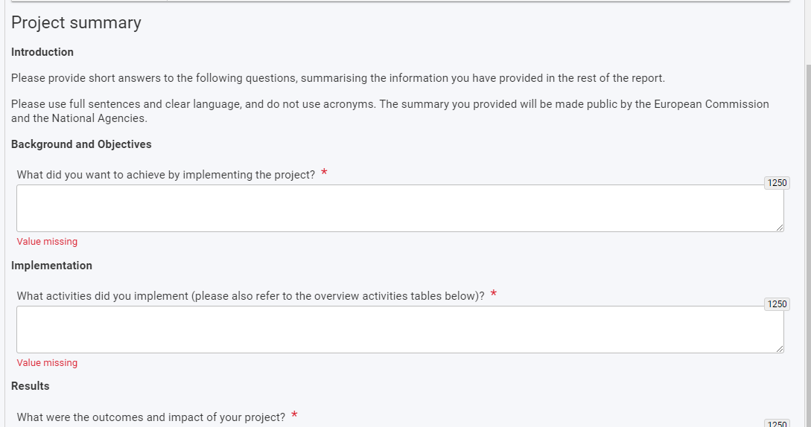

Slide 8
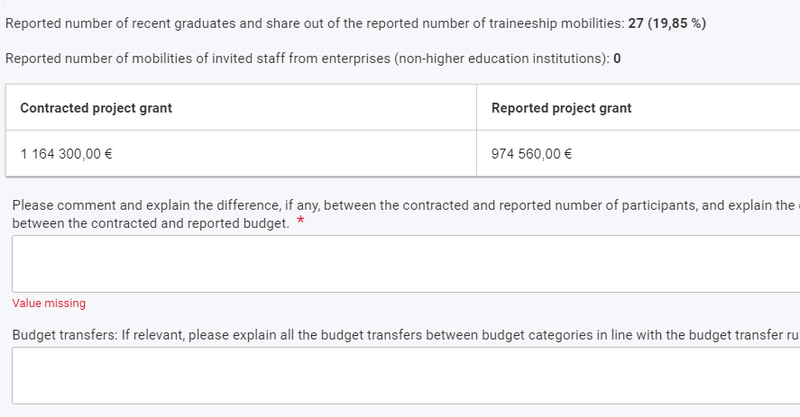
2.Implementation and budget

Slide 9
2. Blended intensive programme(s)
Blended intensive programme ID | Blended intensive programme title | Main target population – type of learner participants | Priority addressed | Contracted number of mobile learner participants | Reported number of mobile learner participants | Receiving higher education institution | Physical duration (days) | Contracted blended intensive programme organisational support | Reported blended intensive programme organisational support | BIP status
[Prefilled from BM –Blended intensive programmes] | [Prefilled from BM –Blended intensive programmes] | [Prefilled from BM –Blended intensive programmes – Type of participants] | [Prefilled from BM –Blended intensive programmes] | [Number of awarded participants in BIP] | [Number of reported participants in BIP] | [display Name of organisation with Mobility role=Receiving HEI] | [Prefilled from BM –Blended intensive programmes] | [Awarded organisational support for the BIP] | [Reported organisational support for the BIP] | [Complete/Draft]
Please comment on the number of reported/achieved blended intensive programmes compared to the contracted ones.
Please provide your assessment on the actual implementation of this blended intensive programme, reported/achieved results including participation of learners and teachers/trainers, partnership cooperation arrangements, lessons learnt, sharing of results, and impact.
In addition, please comment why the blended intensive programme did not reach the minimum requirements in terms of Erasmus+ mobile learners

Slide 10
What if participants’ mobilities are not connected to Blended Intensive Programmes (BIPs)?
If partners of beneficiaries have not managed to encode mobilities to blended intensive programmes (BIPs) coordinated by the beneficiary in time before the final report submission deadline, the beneficiary can explain this in the relevant fields in the BIP part of the final report.
The beneficiary is nevertheless expected to have some record of the actual number of BIP participants, according to the requirements set out in the beneficiary grant agreement.
The National Agency (NA) can review the explanations of the beneficiary during NA validation stage and adapt the final report data accordingly (the version “final report/grant approved by NA”).
Please note that the functionality of connecting participants and their mobility to BIPs has been fully implemented in the Beneficiary Module and should be functioning for all call years.

Slide 11
What should be done where Blended Intensive Programmes (BIPs) had both student and staff learners but it is only possible in the Beneficiary Module (BM) to set the “Type of Participants (learners)” field in the BIP overview as either students or staff?
Beneficiaries can set the “Type of Participants (learners)” field in the BIP overview as the main target group of the BIP.
If there is no main target group, the beneficiary can set it as the type with more expected participants.
It is possible to encode both student and staff learner mobilities to any type of BIP now in BM

Slide 12
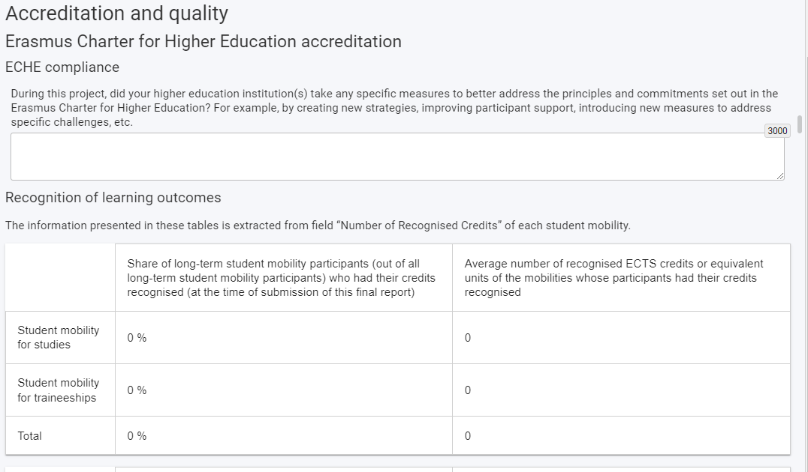
Erasmus Charter for Higher Education accreditation
Please comment and explain the results and, if necessary, explain how you intend to improve them.
Erasmus Charter for Higher Education accreditation
Please describe the mechanisms to report complaints and issues available to your incoming and outgoing students
Staff
Linguistic Support

Slide 13
Erasmus+ priorities in higher education
Inclusion and diversity
- Please describe briefly if your institution(s) has/have an inclusion strategy for mobility activities and any relevant qualitative and quantitative targets. Please include the website where the strategy can be accessed, if applicable.
If applicable, please describe the different outreach activities of your institution(s), if your institutions(s) has/have inclusion officers, is/are working with student unions, or unions of people with fewer opportunities, has/have information on services for incoming students with fewer opportunities published online, etc.
- Please describe briefly how the national criteria for the top-up amount to individual support for students with fewer opportunities is communicated to potential mobility participants.

Slide 14
Digitalisation of mobility management
International dimension
[If the budget share of international mobility > 20%] Please comment why you exceeded the 20% budget share for international mobility.
Please describe briefly how your institution is committing to the digitalisation of the Erasmus+ programme.
Bridge between higher education and research and innovation
Please comment and explain the reported/achieved results in relation to your international strategy and any other relevant aspects.

Slide 15
Please provide any suitable explanations regarding the fact that not all participant reports were submitted at the time of submission of this final report.
What if there are some KA131 participant reports missing?
Beneficiaries can explain in the final report why participant reports are missing. Difficulties with encoding participants and their mobilities on time is a valid reason for any number of missing reports. Beneficiaries must not be penalised during the “NA validation” stage for any missing reports.
Participant report discrepancies
Participant report discrepancies

Slide 16
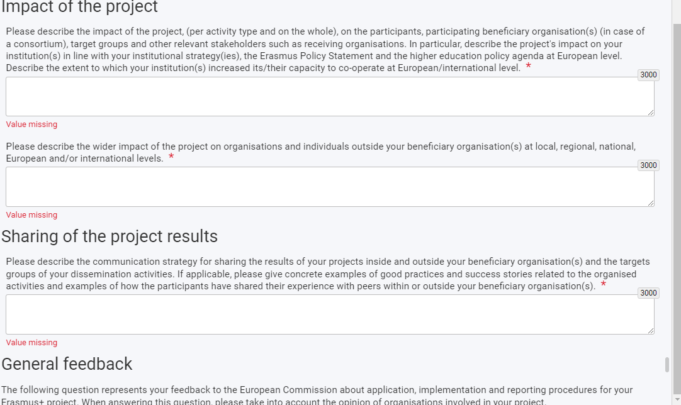

Slide 17
Issue related to mobility data.
Please ask your beneficiaries to check that they have encoded the right country name for international mobilities for KA131 in the Beneficiary Module before the submission of the call 2021 final reports.
What is commonly called South Korea appears as “Korea, Republic Of” while North Korea is listed as “Korea, Democratic People’s Republic Of”.
In addition, mobilities to Puerto Rico must be encoded as mobilities to the United States of America.
Similarly, “United Kingdom” must be used for overseas territories or dependencies related to the UK or the British Crown such as the Channel Islands.
We are currently reviewing the used country lists in order to bring them fully in line with the Erasmus+ programme guide

Slide 18

Beneficiary Module

Slide 19
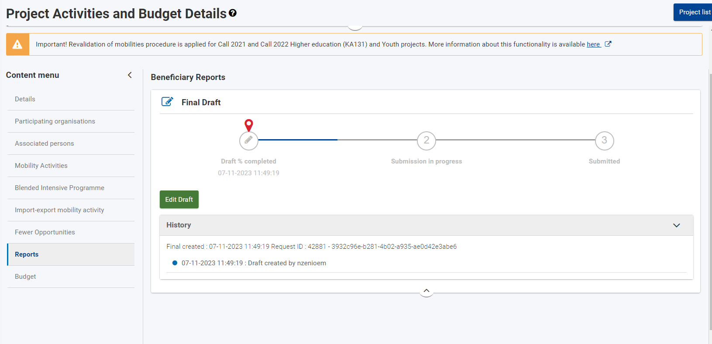
Beneficiary Module

Slide 20
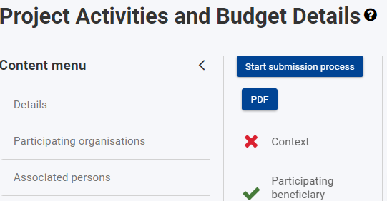

Slide 21
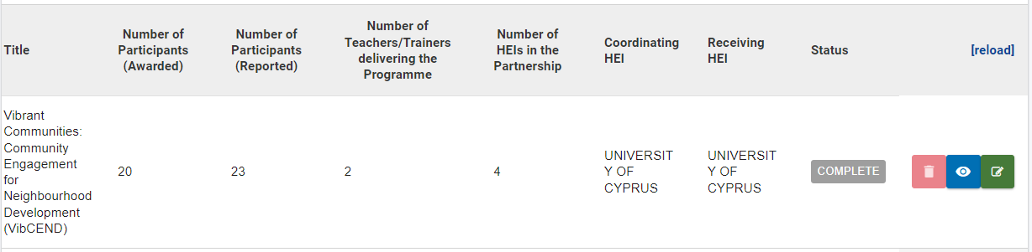
All mobility activities must be in status Complete

Slide 22
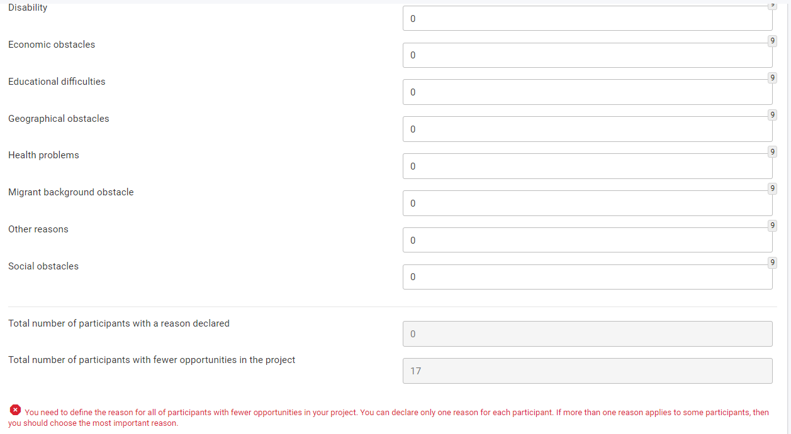
All fewer opportunities participants in the project have a reason declared in the Fewer opportunities section

Slide 24

Conditions for final report submission
Final report can only be submitted if:
All mandatory fields have been filled in
All mobility activities are in status Complete
All fewer opportunities participants in the project have a reason declared in the Fewer opportunities section
Declaration on Honor has been uploaded.
Checklist has been fulfilled
Reported budget/project grant is greater than zero

